Slide 1
Intro to Data structures and algorithms
RP: Imran Latif
imranlatif@cuilahore.edu.pk
Notes:
Introduction slide

Slide 2
Data structures
What is Data Structure?
“A systematic way of storing and organizing data”
A data structure is a specialized format for organizing, processing, retrieving and storing data. or
“The organized collection of data is called data structure”
Array is a simple example

Slide 3
Data structures
A data structure is a storage that is used to store and organize data. It is a way of arranging data on a computer so that it can be accessed and updated efficiently.
There are different basic and advanced types of data structures that are used in almost every program or software system that has been developed. E.g., stack, queue, linked list, binary tree, etc.

Slide 4
Why Data structures?
Data Structures are necessary for designing efficient algorithms. It provides reusability and abstraction.
Using appropriate data structures can help programmers save a good amount of time while performing operations such as storage, retrieval, or processing of data. Manipulation of large amounts of data is easier.

Slide 5
Operations on Data Structure
Important operations usually performed on different data structures
Inserting: Adding a new record to the structure.
Deleting: Removing a record from the structure.
Traversing: Accessing each record exactly once so that certain items in the record may be processed.
Searching: Finding the location of the record with a given key value.
Sorting: Arranging the records in some logical order.
Merging: Combing the records in two different sorted files into a single sorted file.
Different data structures may perform each of these operations with different efficiency

Slide 6
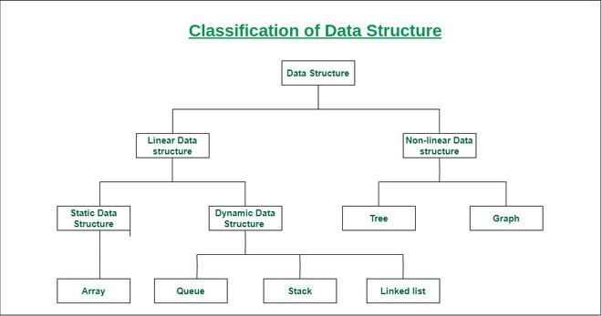
Classification of Data Structure

Slide 7
Types of Data Structure
Linear Data Structure: The data elements are linked to each other in a linear manner. The data elements exists in a certain sequence one after another. Each of them has a successor and/or predecessor.
Example, Arrays, Stack, Queues etc.
Non-Linear Data Structure: The data structure in which the data elements are not arranged in a sequence. Every data element may be attached to many other elements.
Example Tree, Graph

Slide 8
Linear Data Structure
Static data structure: Static data structure has a fixed memory size. It is easier to access the elements in a static data structure. An example of this data structure is an array.
Dynamic data structure: In dynamic data structure, the size is not fixed. It can be randomly updated during the runtime which may be considered efficient concerning the memory (space) complexity of the code. Examples of this data structure are queue, stack, etc.

Slide 9
Physical vs Logical Data Structure
Physical Data Structure
Logical Data Structure
Any data structure for which memory is allocated e.g., array, linked list
It decides or defines how the memory is organized or allocated...
We call array and linked list as the physical data structure because these two data structures decide or define how the memory is organized or how the memory is allocated.
Those data structure for which there is no memory allocated directly (like stack, queues etc.) but by using physical data structure(array, linked-list) we can allocate the memory...
Those data structures which is implemented by using physical data structures are called Logical data structures...

Slide 10
Importance of Data Structures
Data structures bring together the data elements in a logical way and facilitate the effective use, persistence and sharing of data. They provide a formal model that describes the way the data elements are organized.
Data structures are the building blocks for more sophisticated applications. They are designed by composing data elements into a logical unit representing an abstract data type that has relevance to the algorithm or application.

Slide 11
Abstract data types
When an application requires a special kind of data which is not available as a built-in data type
In this type we specify how to store a value for the data, what are the operations that can meaningfully manipulate variables of that kind of data, amount of memory required to store a value
Programmer’s responsibility e.g., dd/mm/yy
Also called user-defined data type
Build using struct/class in C/C++/Java

Slide 12
Abstract data types
Abstract Data type (ADT) is a type (or class) for objects whose behavior is defined by a set of values and a set of operations.
The definition of ADT only mentions what operations are to be performed but not how these operations will be implemented. It does not specify how data will be organized in memory and what algorithms will be used for implementing the operations.
It is called “abstract” because it gives an implementation-independent view.
The process of providing only the essentials and hiding the details is known as abstraction.

Slide 13
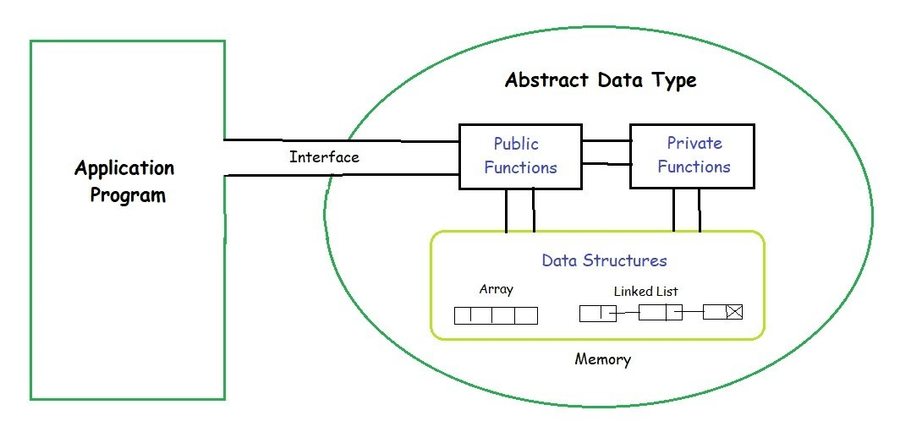
Abstract data types

Slide 14
Algorithms
Algorithm: Sequence of steps designed to perform a particular task.
Computing problems
All can be solved by executing a series of actions (instructions) in a specific order
Algorithm: procedure in terms of
Actions to be executed
The order in which these actions are to be executed

Slide 15
Pseudocode
Artificial, informal language that helps us develop algorithms
Similar to everyday English
Not actually executed on computers
Helps us “think out” a program before writing it
Easy to convert into a corresponding C program
No need to worry about language syntax rules
Consists only of executable statements

Slide 16
Example Algorithm
It is a well-defined set of instructions used to solve a particular problem.
Example:
Write an algorithm for finding the location of the largest element of an array Data.
Pseudo code:
Assume that first element is maximum. Compare the maximum number with each element of the list. If an element greater than maximum number is found, now assume that element as maximum. Do this for each element of the list, until all elements are checked. Current maximum will be actual maximum number in the list.
Algorithm:
Largest-Item (Data, N, Loc)
1. set k:=1, Loc:=1 and Max:=Data[1]
2. while k<=N repeat steps 3, 4
3. If Max < Data[k] then Set Loc:=k and Max:=Data[k]
4. Set k:=k+1
5. write: Max and Loc
6. exit

Slide 17
Flowcharts
Graphical representation of an algorithm
Drawn using certain special-purpose symbols connected by arrows called flow lines
Oval symbol:
Indicates the beginning or end of a program or a section of code
Rectangle symbol (action symbol):
Indicates any type of action
Diamond symbol:
indicates a decision

Slide 18
Example Flowchart
K← 1
Loc ← 1
MAX ← DATA[1]
Is K > N?
Write Loc, MAX
Is MAX <DATA[K]
STOP
MAX = DATA[K]
Loc = K

Slide 19
Binary search: To find a key from an array A in ascending order
found = false; low = 0; high = N – 1;
while (( ! found) && ( low <= high))
{
mid = (low + high)/2;
if (A[mid] = = key)
found = true;
else if (A[mid] > key)
high = mid – 1;
else
low = mid + 1;
}

